Slide 1

Brain Tumor Detection
Term project
Artificial intelligence – CSCI 6660-02
under the guidance of
Prof. Shivanjali Khare
Presented by:
Sai Sruthi Mukka
Bharath Varma Mudundi
Suneela Gudipudi

Slide 2
INTRODUCTION
Brain tumors can be a deadly condition that affects many people worldwide. Despite advancements in medical technology, many people still die each year due to this disease.
Brain tumors can cause a range of symptoms, including headaches, seizures, and cognitive impairment, which can ultimately lead to death.
Approximately 700,000 people in the United States are living with a brain tumor. About 87,000 new cases of primary brain tumors are diagnosed in the US each year.
Early detection and treatment can greatly improve the chances of survival.

Slide 3


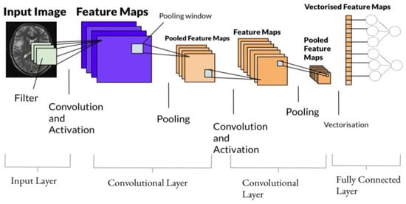


Proposed model
We are proposing a new model using convolutional neural network where the model is built, trained using the images in the dataset.
Once the model is trained, we will give a new x-ray image and the model will detect if the image given has brain tumor or not.

Slide 4
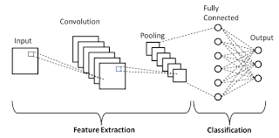
Proposed model
CONVOLUTIONAL NEURAL NETWORK :
A convolutional neural network (CNN) is a type of artificial neural network used in image recognition and processing that is specifically designed to process pixel data .
It has 3 layers:
Convolutional layer , pooling layer and fully connected layer

Slide 5
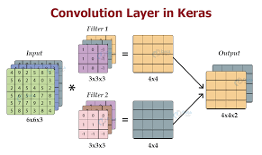
Proposed model
Convolutional layers apply a convolution operation to the input, passing the result to the next layer.
Max pooling is a pooling operation that selects the maximum element from the region of the feature map covered by the filter. Thus, the output after max-pooling layer would be a feature map containing the most prominent features of the previous feature map.
Two types: max pooling and average pooling

Slide 6
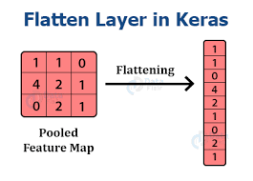
Proposed model
ACTIVATION FUNCTIONS: RELU, SOFTMAX
Flatten layer:
Flattening is converting the data into a 1-dimensional array for inputting it to the next layer.
Dense layer is the regular deeply connected neural network layer.

Slide 7
Initializing CNN model
conv2D layer : It is a 2D Convolution Layer, this layer creates a convolution kernel that is wind with layers input which helps produce a tensor of outputs.
KERNEL_SIZE : This parameter determines the dimensions of the kernel. Common dimensions include 1×1, 3×3, 5×5, and 7×7 which can be passed as (1, 1), (3, 3), (5, 5), or (7, 7) tuples.
ACTIVATION : The activation parameter to the Conv2D class is simply a convenience parameter which allows you to supply a string, which specifies the name of the activation function you want to apply after performing the convolution. Two types of activation functions are used in the project. They are : RELU ,SIGMOID

Slide 8
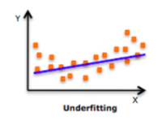
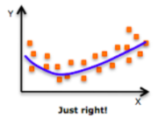
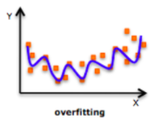
CNN Model
REGULARIZATION: Regularizations are techniques used to reduce the error by fitting a function appropriately on the given training set and avoid overfitting.
Kernel_ regularizer : Regularizer function which is applied to the kernel weights matrix.
Bias _ regularizer : Regularizer function which is applied to the bias vector.

Slide 9
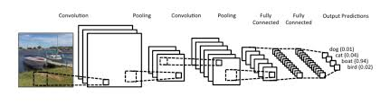
CNN Model
MAX POOLING : Selects maximum element from the region of feature map covered by the filter. It extracts the most prominent features if the previous feature map.
FLATTEN() : Used to flatten the dimensions of the image obtained after convolving it.
DENSE() : Used to make this a fully connected model and is the hidden layer.

Slide 10
Deliverables
Data set
Code in a notebook
Screen Shot for the execution
The model after training

Slide 11
Evaluation Methodology
First, we present our model using CNN and only a few fully connected layers.
The total number of parameters in the model is described.
We then begin training our model, and once we have finished training it, we evaluate it to see if it is a good model or needs improvement.
We evaluate the model's accuracy by looking for a larger DATASET to see if it is good or bad, and if any changes need to be made, we improve it accordingly.

Slide 12
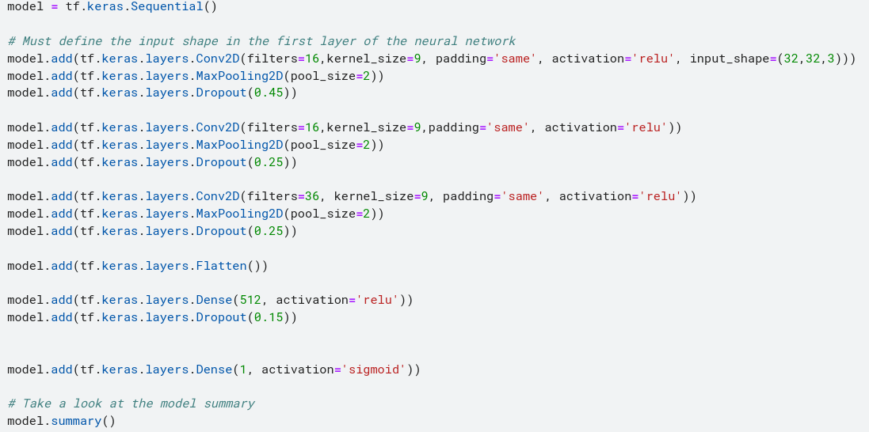
Here is the following model that was created via CNN with fully connected layers.

Slide 13
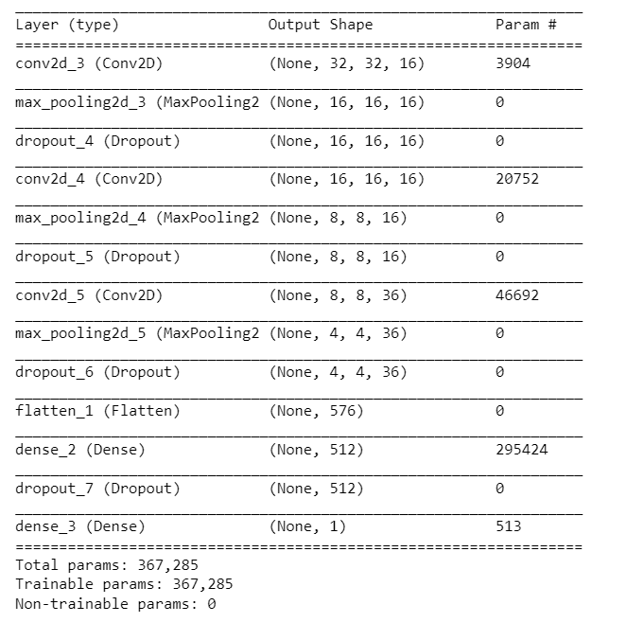
And here is the result for the model summary that shows our model in detail and specifies the total parameters of the model

Slide 14
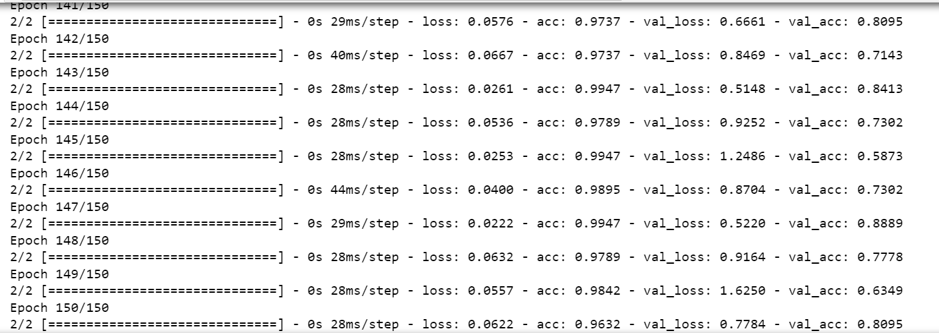
Then we start training our model for epochs just as shown in the figure below

Slide 15
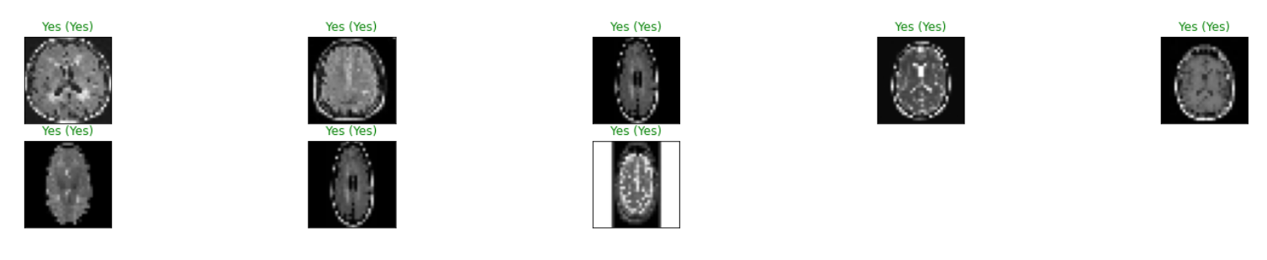
and here are some results for the model when we run it on the test pictures
between the brackets is the correct prediction so we can say that our model gave pretty good results

Slide 16
Conclusion
In conclusion, The model is built, trained and tested.
An image is given to the model, to test from the dataset.
The model will test the image and gives the output based on the input image .
The accuracy of model is 80%.

Slide 17


